Slide 1

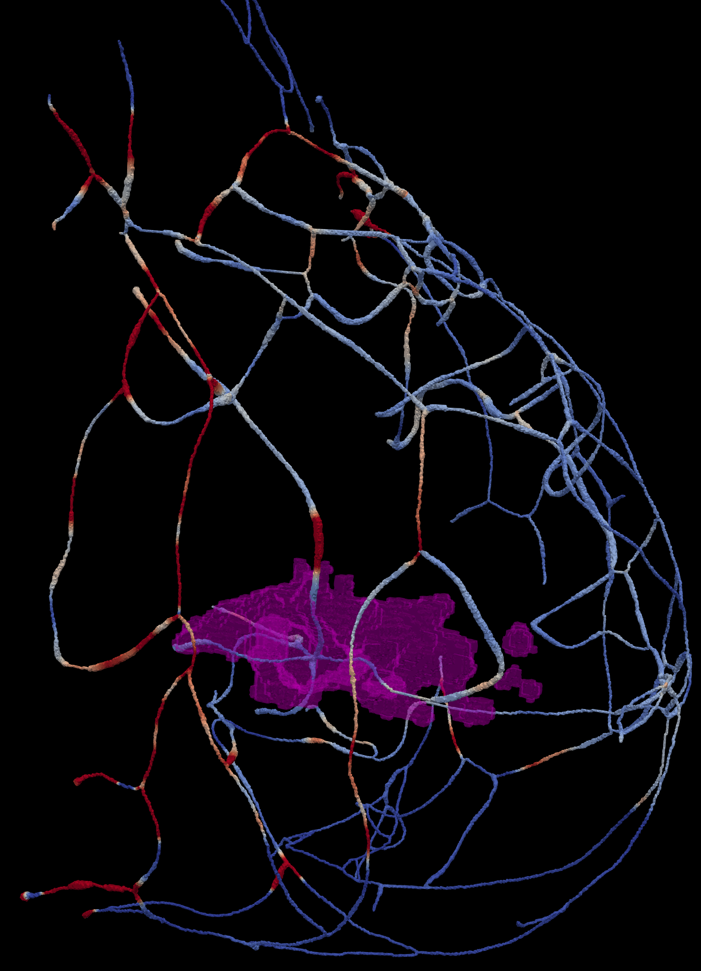
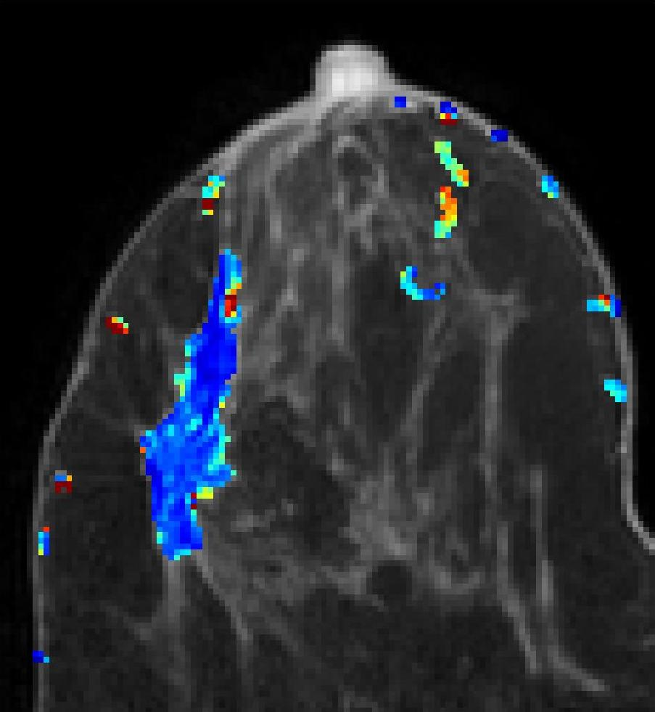

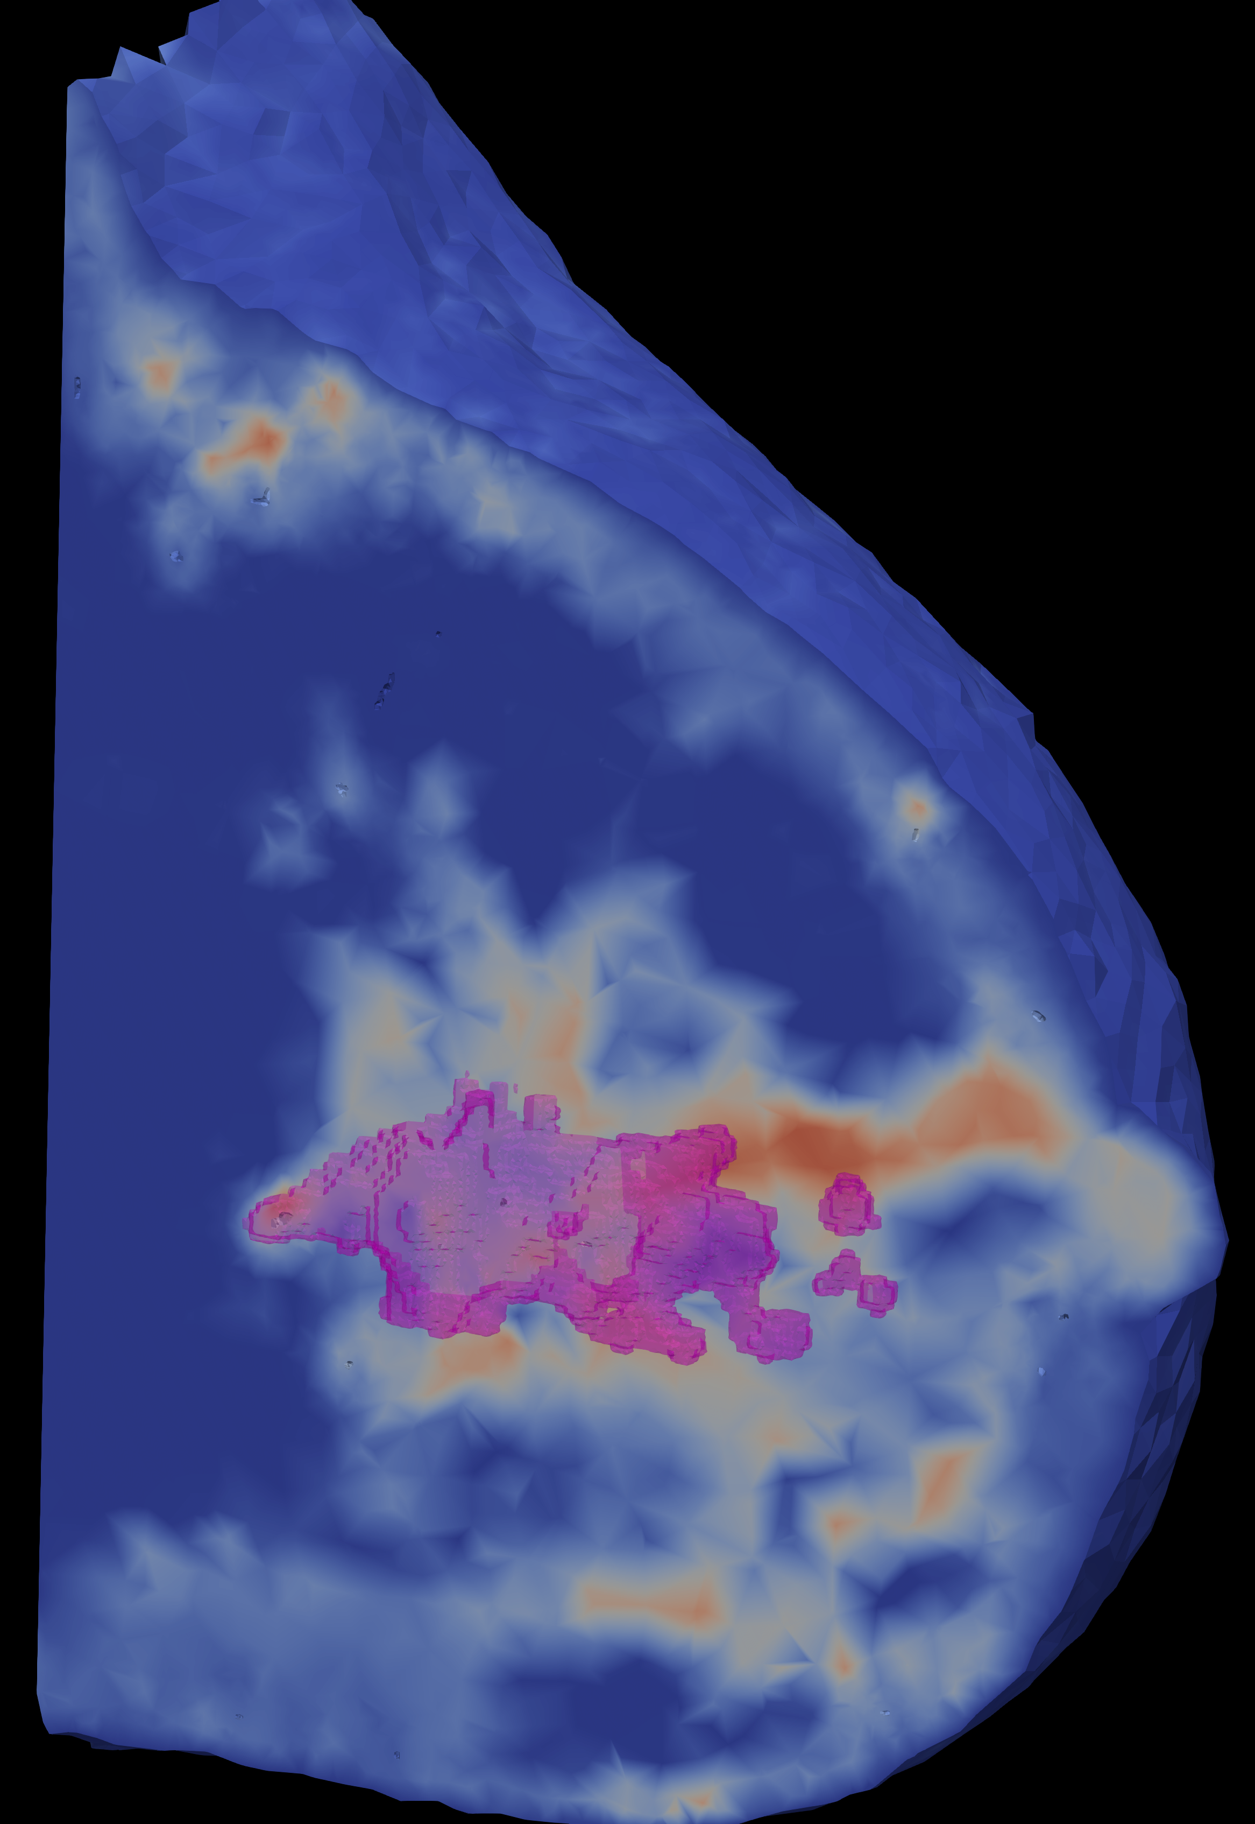
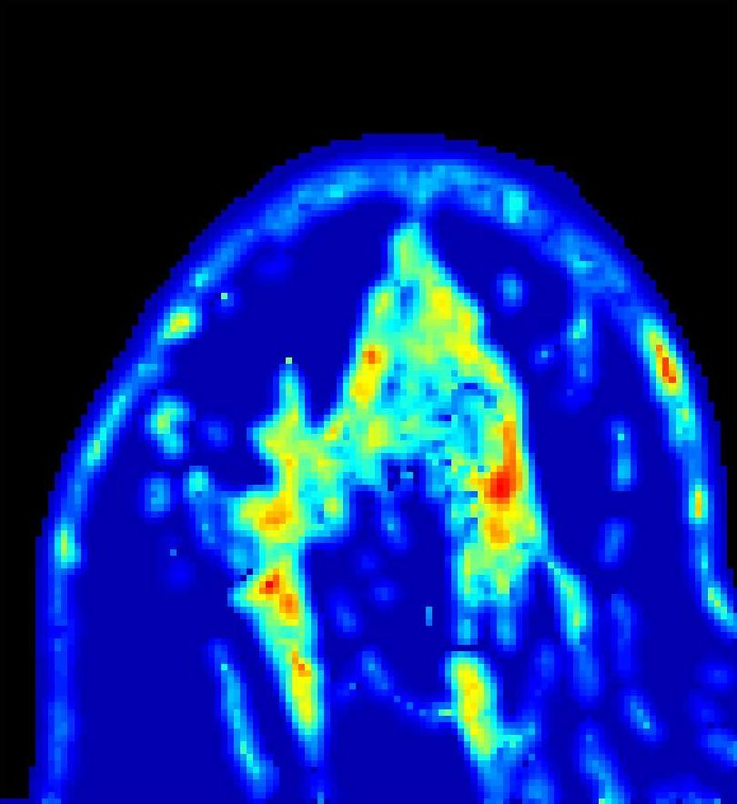

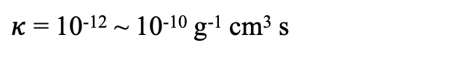
Data processing
0.0
2.5
5.0
×10⁻⁹
K^{trans} --- (Direct, linear scaling) ---> vascular hydraulic conductivity L_{p}
L_{p} (g⁻¹ cm² s)
Median K^{trans}
= 0.16 min⁻¹
Literature values:
Baish et al., Microvas Res, 1997
Pozrikidis & Farrow. Annals Biomed Eng. 2003
Sun Q. Doctoral dissertation (UCL). 2011
~ (7.6 × 10⁻⁹)
L_{p} = 2.5 x 10⁻¹⁰ ~ 2.1 *10⁻⁹ g⁻¹ cm² s
0.0
1.0
2.5
×10⁻⁹
ADC --- (Direct, linear scaling) ---> tissue hydraulic conductivity $κ$
𝜅 (g⁻¹ cm³ s)
Median ADC
= 1.91 x 10⁻⁵ mm²/s
Literature values:
Swabb et al., Cancer research, 1974
Pozrikidis & Farrow. Annals Biomed Eng. 2003
~ (5.0 ×10⁻⁷)
Wu et al., IEEE TMI. 2020
$κ$ = 10⁻¹² ~ 10⁻¹⁰ g⁻¹ cm³ s
/ 25
Notes:
Sequentially we calibrate the spatial-resolved tissue properties using MRI derived parameters. We use a simple linear scaling scheme, which is multiplying a constant coefficient on the estimated Ktrans, and make the scaled value matches with the vascular hydraulic conductivity value reported in literature. Similarly, we scale the estimated ADC to the tissue hydraulic conductivity and diffusivity. The obtained properties are then mapped to the numerical meshes.

